Slide 1
Chapter 3: Exploratory Factor Analysis
For use with Hair, Black, Babin and Anderson, Multivariate Data Analysis 8e © 2018 Cengage Learning EMEA

Slide 2
LEARNING OBJECTIVES
Upon completing this chapter, you should be able to do the following:
Differentiate exploratory factor analysis techniques from other multivariate techniques.
Distinguish between exploratory and confirmatory uses of factor analytic techniques.
Understand the seven stages of applying exploratory factor analysis.
Distinguish between R and Q factor analysis.
Identify the differences between principal component analysis and common factor analysis models.
Describe how to determine the number of factors to extract.
Explain the concept of rotation of factors.
Describe how to name a factor.
Explain the additional uses of exploratory factor analysis.
State the major limitations of exploratory factor analytic techniques.
For use with Hair, Black, Babin and Anderson, Multivariate Data Analysis 8e © 2018 Cengage Learning EMEA

Slide 3
Overview
What Is Exploratory Factor Analysis?
A Hypothetical Example of Exploratory Factor Analysis
Factor Analysis Decision Process
Stage 1: Objectives of Exploratory Factor Analysis
Stage 2: Designing an Exploratory Factor Analysis
Stage 3: Assumptions in Exploratory Factor Analysis
Stage 4: Deriving Factors and Assessing Overall Fit
Stage 5: Interpreting the Factors
Stage 6: Validation of Exploratory Factor Analysis
Stage 7: Data Reduction—Additional Uses of Exploratory Factor Analysis Results
An Illustrative Example
For use with Hair, Black, Babin and Anderson, Multivariate Data Analysis 8e © 2018 Cengage Learning EMEA

Slide 4
What Is Exploratory Factor Analysis?
For use with Hair, Black, Babin and Anderson, Multivariate Data Analysis 8e © 2018 Cengage Learning EMEA

Slide 5
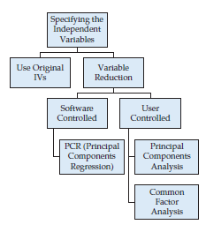
Exploratory Factor Analysis Defined
An interdependence technique whose primary purpose is to define the underlying structure among the variables in the analysis.
A primary element in
Variable Specification while Managing the Variate
For use with Hair, Black, Babin and Anderson, Multivariate Data Analysis 8e © 2018 Cengage Learning EMEA

Slide 6
What is Exploratory Factor Analysis?
Exploratory Factor Analysis (EFA) . . .
Examines the interrelationships among a large number of variables and then attempts to explain them in terms of their common underlying dimensions.
These common underlying dimensions are referred to as factors or components.
EFA is a summarization and data reduction technique that does not have independent and dependent variables, but is an interdependence technique in which all variables are considered simultaneously.
For use with Hair, Black, Babin and Anderson, Multivariate Data Analysis 8e © 2018 Cengage Learning EMEA

Slide 7
A Hypothetical Example of Exploratory Factor Analysis
For use with Hair, Black, Babin and Anderson, Multivariate Data Analysis 8e © 2018 Cengage Learning EMEA

Slide 8
Correlation Matrix for Store Image Elements
Situation: retailer would like to know whether consumers think in more general evaluative dimensions rather than in just the specific items
Research Plan: nine store image elements, including measures of the product offering, store personnel, price levels, and in-store service and experiences
For use with Hair, Black, Babin and Anderson, Multivariate Data Analysis 8e © 2018 Cengage Learning EMEA

Slide 9
Correlation Matrix After Grouping Using Factor Analysis
Results: Shaded areas represent variables likely to be grouped together by exploratory factor analysis.
For use with Hair, Black, Babin and Anderson, Multivariate Data Analysis 8e © 2018 Cengage Learning EMEA

Slide 10
Interpreting the Factor Analysis Results
Variables Factors
V₃ Return Policy
V₈ In-store Service
In-store Experience
V₉ Store Atmosphere
V₂ store Personnel
V₆ Assortment Depth
V₇ Assortment Width
Product Offerings
V₄ Product Availability
V₁ Price Level
Value
V₅ Product Quality
For use with Hair, Black, Babin and Anderson, Multivariate Data Analysis 8e © 2018 Cengage Learning EMEA

Slide 11
Exploratory Factor Analysis Decision Process
Stage 1: Objectives of Exploratory Factor Analysis (EFA)
Stage 2: Designing an Exploratory Factor Analysis
Stage 3: Assumptions in Exploratory Factor Analysis
Stage 4: Deriving Factors and Assessing Overall Fit
Stage 5: Interpreting the Factors
Stage 6: Validation of Exploratory Factor Analysis
Stage 7: Additional uses of Exploratory Factor Analysis Results
For use with Hair, Black, Babin and Anderson, Multivariate Data Analysis 8e © 2018 Cengage Learning EMEA

Slide 12
Stage 1: Objectives of Exploratory Factor Analysis
Specifying the Unit of Analysis
Achieving Data Summarization Versus Data Reduction
Variable Selection
Using Factor Analysis with Other Multivariate Techniques
For use with Hair, Black, Babin and Anderson, Multivariate Data Analysis 8e © 2018 Cengage Learning EMEA

Slide 13
Types of Factor Analysis
Exploratory Factor Analysis (EFA)
used to discover the factor structure of a construct and examine its reliability. It is data driven.
Confirmatory Factor Analysis (CFA)
used to confirm the fit of the hypothesized factor structure to the observed (sample) data. It is theory driven.
For use with Hair, Black, Babin and Anderson, Multivariate Data Analysis 8e © 2018 Cengage Learning EMEA

Slide 14
EFA Unit of Analysis and Objectives
Unit of Analysis
Variables – most common application, termed R-factor analysis.
Cases – grouping cases, similar to cluster analysis, termed Q-factor analysis.
Data Summarization versus Data Reduction
Data summarization – defining structure through underlying dimensions that, when interpreted and understood, describe the data in a much smaller number of concepts than the original individual variables. The basis for scale development.
Data reduction – extends the process of data summarization by deriving an empirical value (factor score or summated scale) for each dimension (factor) and then substituting this value for the original variable values in subsequent analysis.
For use with Hair, Black, Babin and Anderson, Multivariate Data Analysis 8e © 2018 Cengage Learning EMEA

Slide 15
Variable Selection and Use with Other Techniques
Three Elements in variable selection
Variable specification – researcher must specifically designate variables to be analyzed.
Factors are always produced – EFA always generates factors, researcher has the responsibility to evaluate the usefulness and validity of the factors.
Factors require multiple variables – EFA must have at least two correlated variables to form a factor. Thus, variables which are not included in a specified factor are not “defective” in some manner, it is just that no other correlated variables were included in the analysis.
Using Factor Analysis with Other Multivariate Techniques
Factors may identify concepts more useful than individual variables.
Factors help mitigate the impact of multicollinearity on the interpretation of correlated variables.
For use with Hair, Black, Babin and Anderson, Multivariate Data Analysis 8e © 2018 Cengage Learning EMEA

Slide 16
Stage 2: Designing an Exploratory Factor Analysis
Variable Selection and Measurement Issues
Sample Size
Correlations among Variables or Respondents
For use with Hair, Black, Babin and Anderson, Multivariate Data Analysis 8e © 2018 Cengage Learning EMEA

Slide 17
EFA Research Design
Factor analysis is performed most often only on metric variables
Specialized methods exist for the use of dummy variables, but a small number of “dummy variables” can be included in a set of metric variables that are factor analyzed.
If a study is being designed to reveal factor structure, strive to have at least five variables for each proposed factor.
For sample size:
the sample must have more observations than variables.
the minimum absolute sample size should be 50 observations.
Maximize the number of observations per variable, with a minimum of five and hopefully at least ten observations per variable.
Correlation matrix (“R analysis”) most often performed, although similarity/distance matrix (“Q analysis”) also an option.
For use with Hair, Black, Babin and Anderson, Multivariate Data Analysis 8e © 2018 Cengage Learning EMEA

Slide 18
Stage 3: Assumptions in Factor Analysis
Conceptual Issues
Statistical Issues
For use with Hair, Black, Babin and Anderson, Multivariate Data Analysis 8e © 2018 Cengage Learning EMEA

Slide 19
Assumptions of EFA
Conceptual
Before the factor analysis is performed, there must be a strong conceptual foundation to support the assumption that a structure does exist.
Assume a homogeneity of sub-sample factor solutions
Statistical Issues Addressing Multicollinearity
A statistically significant Bartlett’s test of sphericity (sig. < .05) indicates that sufficient correlations exist among the variables to proceed with an exploratory factor analysis.
More diagnostic test is the MSA (measure of sampling adequacy).
Measured by the Kaiser-Meyer-Olkin (KMO) statistic that indicates if a set of variables is likely identify a good factor solution based on correlations/partial correlations.
KMO statistic exists for each individual variable and an overall value that can vary from 0 to 1.0.
KMO value must exceed .50 for both the overall test and each individual variable. Variables with values less than .50 should be omitted from the factor analysis one at a time, with the smallest one being omitted each time, until both overall and all individual values are above .50
For use with Hair, Black, Babin and Anderson, Multivariate Data Analysis 8e © 2018 Cengage Learning EMEA

Slide 20
Bartlett’s Test of Sphericity
Bartlett’s Test of Sphericity compares an observed correlation matrix to the identity matrix.
Essentially it checks to see if there is a certain redundancy between the variables that we can summarize with a few number of factors.
The null hypothesis of the test is that the variables are orthogonal, i.e. not correlated.
The alternative hypothesis is that the variables are not orthogonal, i.e. they are correlated enough to where the correlation matrix diverges significantly from the identity matrix.
If the p-value from Bartlett’s Test of Sphericity is lower than the chosen significance level, then our dataset is suitable for a data reduction technique.

Slide 21
Partial correlation
The partial correlation is the correlation of two variables while controlling for a third or more other variables.
The partial correlation coefficient is a measure of the strength of the linear relationship between two variables after entirely controlling for the effects of other variables.

Slide 22
R code
install.packages('EFAtools')
library('EFAtools')
HBAT.cor <- cor(HBAT[,c(7:19)])
KMO(HBAT.cor) # p. 129 Table 4
BARTLETT(HBAT.cor,N=100)
BARTLETT(HBATc719)
install.packages('corpcor')
library('corpcor')
round(cor2pcor(cov(HBAT[,c(7:19)])) ,3) # p. 129 Table 4

Slide 23
Stage 4: Deriving Factors and Assessing Overall Fit
Selecting the factor extraction method – common vs. component analysis.
Stopping Rules: Criteria for the Number of Factors to Extract.
Alternatives to Principal Components and Common Factor Analysis.
For use with Hair, Black, Babin and Anderson, Multivariate Data Analysis 8e © 2018 Cengage Learning EMEA

Slide 24
Selecting the factor extraction method
Partitioning the Variance
Common variance
Variance of a variable that is shared with all other variables in the analysis.
Results from the variable’s correlations with all other variables in the analysis.
Variable communality is the estimate of its shared, or common, variance among the variables as represented by the derived factors.
Unique variance – composed of Specific and Error variance
Specific variance – cannot be explained by the correlations to the other variables but reflects the unique characteristics of that variable apart from the other variables in the analysis.
Error variance – due to unreliability in the data-gathering process, measurement error, or a random component in the measured phenomenon.
For use with Hair, Black, Babin and Anderson, Multivariate Data Analysis 8e © 2018 Cengage Learning EMEA

Slide 25
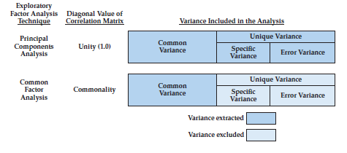
How do they differ?
Extraction Method Determines the Types of Variance
Carried into the Factor Matrix
For use with Hair, Black, Babin and Anderson, Multivariate Data Analysis 8e © 2018 Cengage Learning EMEA

Slide 26
Which One To Use?
Principal component analysis is most appropriate when:
data reduction is a primary concern, focusing on the minimum number of factors needed to account for the maximum portion of the total variance represented in the original set of variables.
prior knowledge suggests that specific and error variance represent a relatively small proportion of the total variance.
the principal component results are used as a preliminary step in the scale development process.
Common factor analysis is most appropriate when:
the primary objective is to identify the latent dimensions or constructs represented in the common variance of the original variables, as typified in the scale development process.
the researcher has little knowledge about the amount of specific and error variance and therefore wishes to eliminate this variance.
For use with Hair, Black, Babin and Anderson, Multivariate Data Analysis 8e © 2018 Cengage Learning EMEA

Slide 27
Stopping Rules: Criteria for the Number of Factors to Extract
A Priori Criterion
researcher knows how many factors to extract and specifies for factor extraction.
Latent Root Criterion (aka Kaiser rule)
most commonly used technique.
factors having latent roots or eigenvalues greater than 1 are considered significant.
most applicable to principal components analysis where the diagonal value representing the amount of variance for each variable is 1.0.
less accurate with a small number of variables or lower communalities.
Percentage of Variance
Extract enough components to achieve a specified cumulative percentage of total variance extracted.
For use with Hair, Black, Babin and Anderson, Multivariate Data Analysis 8e © 2018 Cengage Learning EMEA

Slide 28
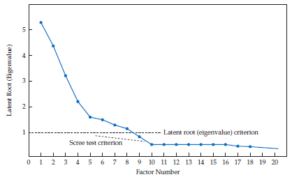
Stopping Rules: Criteria for the Number of Factors to Extract
Scree Test Criterion
Identify the optimum number of factors that can be extracted before the amount of unique variance begins to dominate the common variance structure.
Plot of latent root (eigenvalues) defines “elbow,” the point at which the curve first begins to straighten out.
Considered to represent those factors containing more unique rather than common variance.
Most researchers do not include the elbow, but rather retain all of the preceding factors.
Parallel Test
For use with Hair, Black, Babin and Anderson, Multivariate Data Analysis 8e © 2018 Cengage Learning EMEA

Slide 29
Stopping Rules: Criteria for the Number of Factors to Extract
Parallel Analysis
Empirical measure based on the specific characteristics (i.e., number of variables and sample size) of the dataset being analyzed.
Procedure
Generate a large number (e.g., 500 or 1000) simulated datasets with random values for the same number of variables and sample size.
Apply either principal components or common factor analysis to each dataset.
Calculate average eigenvalue across datasets for each factor (i.e., first, second, . . . )
Compare to eigenvalues for original data and retain all factors that are greater than average eigenvalues from random datasets
Variants of this rule suggest taking the upper bound (95th percentile) of the simulated eigenvalues.
Applicable equally well to principal components or common factor methods
For use with Hair, Black, Babin and Anderson, Multivariate Data Analysis 8e © 2018 Cengage Learning EMEA

Slide 30
R code
library('EFAtools')
PARALLEL(HBAT.cor,N=100) # takes much time to get the result
install.packages(psych)
library(psych)
fa.parallel(HBAT.cor,n.obs=100)

Slide 31
Rules of Thumb – Choosing Factor Models and Number of Factors
While principal component and common factor analysis models yield similar results in most research settings (30 or more variables or communalities of .60 for most variables):
the principal component analysis model is most appropriate when data reduction is paramount.
the common factor model is best in well-specified theoretical applications.
A decision on the number of retained factors should be based on several considerations:
Use several stopping criteria to determine the initial number of factors to retain.
Factors With Eigenvalues greater than 1.0.
A pre-determined number based on research objectives and/or prior research.
Enough factors for a specified percentage of variance explained (e.g., usually 60%).
Factors shown by the scree test to have substantial amounts of common variance (i.e, before inflection point).
Factors which have eigenvalues greater than factors from randomly-generated data.
Factors above the threshold established by parallel analysis.
More factors when there is heterogeneity among sample subgroups.
Consideration of several alternative solutions (one more and one less factor than the initial solution) to ensure the best structure is identified.
For use with Hair, Black, Babin and Anderson, Multivariate Data Analysis 8e © 2018 Cengage Learning EMEA

Slide 32
Alternatives to Principal Components and Common Factor Analysis
Factor Analysis of Categorical Data
Optimal scaling is a process to derive interval measurement properties for variables which were originally nominal or ordinal measures.
Two issues
optimal scaling works within the variable set specified (e.g., maximizes the correlations among the variables in the analysis), but this scaling may change in other analyses.
the researcher sets a series of allowable transformations (e.g., retain ordinality or not).
Variable Clustering
Variant of PCA popularized in the PROC VARCLUS of SAS.
Form of “sequential” factor extraction where factors are split to form new factors
Benefits include:
not impacted by the number of variables included like PCA.
based on a hierarchical process of component formation.
introduces additional diagnostics for selecting the most representative variable(s).
For use with Hair, Black, Babin and Anderson, Multivariate Data Analysis 8e © 2018 Cengage Learning EMEA

Slide 33
Step 5: Interpreting the Factors
The Three Processes of Factor Interpretation
Factor Extraction
Rotation of Factors
Judging the Significance of Factor Loadings
Interpreting a Factor Matrix
For use with Hair, Black, Babin and Anderson, Multivariate Data Analysis 8e © 2018 Cengage Learning EMEA

Slide 34
The Three Processes of Factor Interpretation
Estimate the Factor matrix
Compute unrotated factor loadings – correlation of variable and factor.
If used strictly for data reduction, process can stop here.
Factor Rotation
Employ a rotational method to achieve simpler and theoretically more meaningful factor solutions.
In most cases rotation of the factors improves the interpretation by reducing some of the ambiguities that often accompany initial unrotated factor solutions.
Factor Interpretation and Respecification
evaluate the (rotated) factor loadings for each variable in order to determine that variable’s role and contribution in determining the factor structure.
Respecification involves eliminating variables or extract different number of factors.
For use with Hair, Black, Babin and Anderson, Multivariate Data Analysis 8e © 2018 Cengage Learning EMEA

Slide 35
Rotation of Factors
Procedure
The reference axes of the factors are turned about the origin until some other position has been reached. Loadings of each variable remain fixed relative to other loadings.
Impact
The ultimate effect of rotating the factor matrix is to redistribute the variance from earlier factors to later ones to achieve a simpler, theoretically more meaningful factor pattern.
Alternative Methods
Orthogonal rotation – simplest approach which maintains orthogonality of factors.
Most common method – VARIMAX.
Oblique rotation – allows for correlation among rotated factors.
For use with Hair, Black, Babin and Anderson, Multivariate Data Analysis 8e © 2018 Cengage Learning EMEA

Slide 36
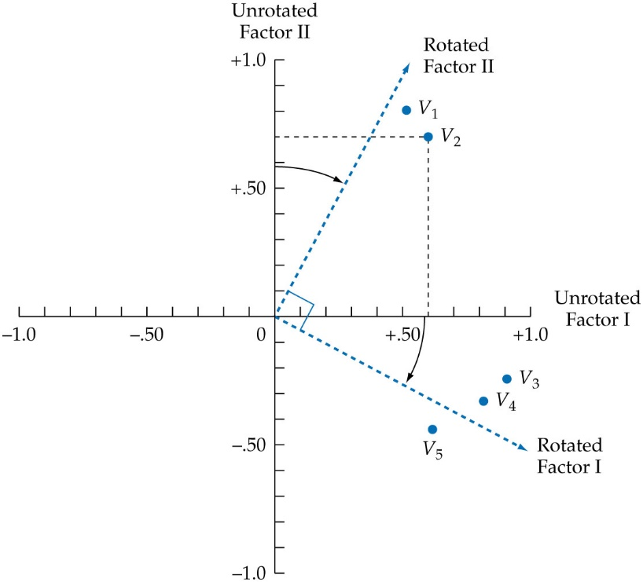
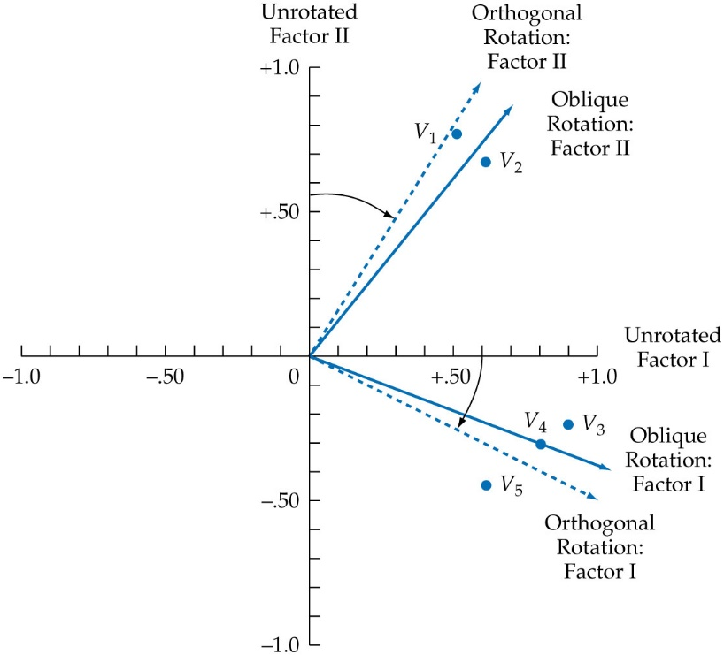
Comparing the Two Rotation Methods
Orthogonal Rotation Oblique rotation
For use with Hair, Black, Babin and Anderson, Multivariate Data Analysis 8e © 2018 Cengage Learning EMEA

Slide 37
Rules of Thumb – Choosing Factor Rotation Methods
Orthogonal rotation methods . . .
are the most widely used rotational methods.
are the preferred method when the research goal is data reduction to either a smaller number of variables or a set of uncorrelated measures for subsequent use in other multivariate techniques.
Oblique rotation methods . . .
best suited to the goal of obtaining several theoretically meaningful factors or constructs because, realistically, very few constructs in the “real world” are uncorrelated.
For use with Hair, Black, Babin and Anderson, Multivariate Data Analysis 8e © 2018 Cengage Learning EMEA

Slide 38
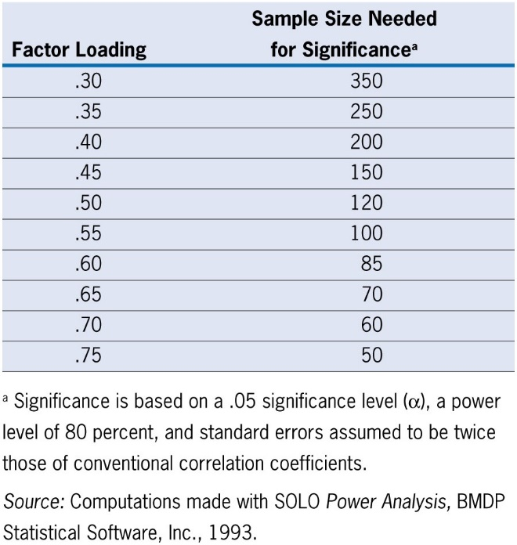
Judging the Significance of Factor Loadings
Practical Significance For Assessing Structure
Equivalent to zero: less than +/- .10
Minimal Level: in the range of +/- .30 to +/- .40
Practically Significant: values of +/- .50 or greater
Well-defined structure: exceeding +/- .70
Factor Structure
A smaller loading is needed given either a larger sample size or a larger number of variables.
A larger loading is needed given a factor solution with a larger number of factors.
Statistical Significance
Ensuring adequate statistical power, significant loadings can be identified by sample size.
For use with Hair, Black, Babin and Anderson, Multivariate Data Analysis 8e © 2018 Cengage Learning EMEA

Slide 39
Interpreting a Factor Matrix
Interpretation needed when factors used beyond solely data reduction
Objective is simple structure, characterized by two principles:
each variable has a high/significant loading on one factor only, and
each factor has high/significant loadings for only a subset of items.
Five step process
Examine the factor matrix of loadings.
Identify the significant loading(s) for each variable.
Assess the communalities of the variables.
Respecify the factor model if needed.
Label the factors.
For use with Hair, Black, Babin and Anderson, Multivariate Data Analysis 8e © 2018 Cengage Learning EMEA

Slide 40
Step 1: Examine the factor matrix of loadings
Starting Point:
Factor matrix has loadings of every variable on every factor extracted.
Examine each variable for the highest loading/significant loading on a factor.
Cross-loading – when a variable has a significant loading on more than one factor.
Two Principles to Assist in Identifying Cross-loadings
Compare variances, Not Loadings.
Variance (i.e., squared loading) is ultimate objective of factor analysis, so use that measure.
Compare ratios of variances.
Relative magnitude expressed as the ratio of two variances (larger variance / smaller variance) which “scales” the variance difference to the size of the two variances.
For use with Hair, Black, Babin and Anderson, Multivariate Data Analysis 8e © 2018 Cengage Learning EMEA

Slide 41
Process For Identifying Cross-Loadings
Identify potential cross-loadings
Both loadings for a variable must be above the threshold for significance (e.g., .30 or .40).
Compute the ratio of the squared loadings
Square each of the loadings and then compute the ratio of the larger loading to the smaller loading.
Designate the pair of loadings as follows based on the ratio:
Between 1.0 and 1.5 — problematic cross-loading and the variable with smaller loading a strong candidate for elimination to achieve simple structure.
Between 1.5 and 2.0 — potential cross-loading, with deletion of a variable based on interpretability of resulting factors.
Greater than 2.0 — ignorable cross-loading, where smaller loading, while significant, can be ignored for purposes of interpretation.
For use with Hair, Black, Babin and Anderson, Multivariate Data Analysis 8e © 2018 Cengage Learning EMEA

Slide 42
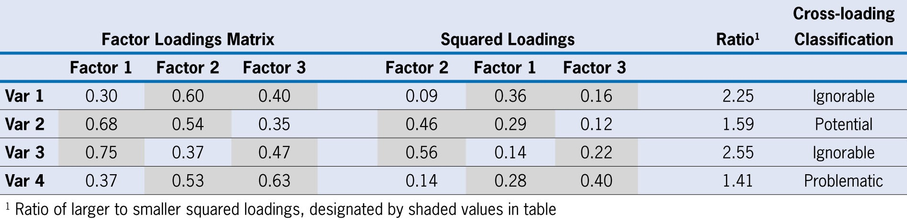
Example for Identifying Cross-Loadings
For use with Hair, Black, Babin and Anderson, Multivariate Data Analysis 8e © 2018 Cengage Learning EMEA

Slide 43
Step 3: Assess the Communalities of the Variables
Communality
Represents the amount of variance accounted for by the factor solution for each variable.
Calculated as the sum of the squared loadings across all retained factors.
Use as an Evaluative Measure
view the communalities to assess whether the variables meet acceptable levels of explanation.
For example, a researcher may specify that at least one-half of the variance of each variable must be taken into account. Using this guideline, the researcher would identify all variables with communalities less than .50 as not having sufficient explanation.
For use with Hair, Black, Babin and Anderson, Multivariate Data Analysis 8e © 2018 Cengage Learning EMEA

Slide 44
Step 4: Respecify the Factor Model if Needed
Three conditions indicating possible respecification
a variable has no significant loadings.
even with a significant loading, a variable’s communality is deemed too low.
a variable has a cross-loading.
If respecification is needed, several options are available . . .
Ignore the problematic variable.
Deletion of variables from the analysis.
Use a different rotational approach.
Extract a different number of factors.
Change the method of extraction.
For use with Hair, Black, Babin and Anderson, Multivariate Data Analysis 8e © 2018 Cengage Learning EMEA

Slide 45
Step 5: Label the Factors
Objective:
Assign some meaning to the pattern of factor loadings.
Variables with higher loadings are considered more important and have greater influence on the name or label selected to represent a factor.
Considerations
The signs are interpreted just as with any other correlation coefficients. For each factor, like signs mean the variables are positively related, and opposite signs mean the variables are negatively related.
The label is intuitively developed by the researcher based on its appropriateness for representing the underlying dimensions of a particular factor.
For use with Hair, Black, Babin and Anderson, Multivariate Data Analysis 8e © 2018 Cengage Learning EMEA

Slide 46
Rules of Thumb – Interpreting The Factors
An optimal structure exists when all variables have high loadings only on a single factor.
Variables that cross-load (load highly on two or more factors) are usually deleted unless theoretically justified or the objective is strictly data reduction.
Variables should generally have communalities of greater than .50 to be retained in the analysis.
Respecification of a factor analysis can include options such as:
deleting a variable(s),
changing rotation methods, and/or
increasing or decreasing the number of factors.
For use with Hair, Black, Babin and Anderson, Multivariate Data Analysis 8e © 2018 Cengage Learning EMEA

Slide 47
Stage 6: Validation of Exploratory Factor Analysis
Use of Replication or a Confirmatory Perspective
Assessing Factor Structure Stability
Detecting Influential Observations
For use with Hair, Black, Babin and Anderson, Multivariate Data Analysis 8e © 2018 Cengage Learning EMEA

Slide 48
Approaches to Validation
Use of Replication or a Confirmatory Perspective
assess the replicability/generalizability of the results, either with a split sample in the original dataset or with a separate sample.
pursue a confirmatory analysis, most likely with structural equation modeling.
Assessing Factor Structure Stability
Larger samples provide more confidence as to generalizability and stability.
Detecting Influential Observations
estimate the model with and without observations identified as outliers to assess their impact on the results. If omission of the outliers is justified, the results should have greater generalizability.
For use with Hair, Black, Babin and Anderson, Multivariate Data Analysis 8e © 2018 Cengage Learning EMEA

Slide 49
Stage 7: Additional Uses of EFA Results
Selecting Surrogate Variables for Subsequent Analysis
Creating Summated Scales
Computing Factor Scores
Selecting among the Three Methods
For use with Hair, Black, Babin and Anderson, Multivariate Data Analysis 8e © 2018 Cengage Learning EMEA

Slide 50
Selecting Surrogate Variables for Subsequent Analysis
A single variable selected to represent the factor in other analyses
Typically, variable with highest loading is selected to represent a factor.
Advantages:
simple to administer and interpret.
Disadvantages:
does not represent all “facets” of a factor.
prone to measurement error.
For use with Hair, Black, Babin and Anderson, Multivariate Data Analysis 8e © 2018 Cengage Learning EMEA

Slide 51
Creating Summated Scales
Composite value calculated (e.g., mean) from variables loading highly on the factor
only as good as the items used to represent the construct. While it may pass all empirical tests, it is useless without theoretical justification.
Advantages:
compromise between the surrogate variable and factor score options.
reduces measurement error.
represents multiple facets of a concept.
easily replicated across studies.
Disadvantages:
includes only the variables that load highly on the factor.
not necessarily orthogonal.
requires extensive analysis of reliability and validity issues.
For use with Hair, Black, Babin and Anderson, Multivariate Data Analysis 8e © 2018 Cengage Learning EMEA

Slide 52
Assessing Summated Scales
Unidimensionality
Never create a summated scale without first assessing its unidimensionality with exploratory or confirmatory factor analysis.
Reliability
With unidimensionality, its reliability score, as measured by Cronbach’s alpha:
should exceed a threshold of .70, although a .60 level can be used in exploratory research.
the threshold should be raised as the number of items increases, especially as the number of items approaches 10 or more.
Validity
With reliability established, validity should be assessed in terms of:
convergent validity = scale correlates with other similar scales.
discriminant validity = scale is sufficiently different from other related scales.
nomological validity = scale “predicts” as theoretically suggested.
For use with Hair, Black, Babin and Anderson, Multivariate Data Analysis 8e © 2018 Cengage Learning EMEA

Slide 53
R code
library(psych)
HBAT.fa4C <- fa(HBAT[,c(7:11,13:15, 17,19)],nfactors=4, rotate='oblimin',fm='ml')
print(HBAT.fa4C$loadings,cutoff = 0.3)
fa.diagram(HBAT.fa4C)
HBAT.fa4C$valid # p. 140
HBAT.fa4C$TLI
cor(HBAT.fa4C$scores) # p. 142

Slide 54
Computing Factor Scores
Software computes composite measure of factor based on loadings
Advantages:
represents all variables loading on the factor.
best method for complete data reduction.
by default, factors (and factor scores) are orthogonal and can avoid complications caused by multicollinearity.
Disadvantages:
interpretation more difficult since all variables contribute through loadings.
difficult to replicate across studies.
For use with Hair, Black, Babin and Anderson, Multivariate Data Analysis 8e © 2018 Cengage Learning EMEA

Slide 55
An Illustrative Example of EFA
For use with Hair, Black, Babin and Anderson, Multivariate Data Analysis 8e © 2018 Cengage Learning EMEA

Slide 56
Research Design
Research Objective:
Assess dimensional structure among 13 Performance Perception Variables
Variables used
Variable Description Variable Type
Performance Perceptions Variables
X6 Product Quality metric
X7 E-Commerce Activities/Website metric
X8 Technical Support metric
X9 Complaint Resolution metric
X10 Advertising metric
X11 Product Line metric
X12 Salesforce Image metric
X13 Competitive Pricing metric
X14 Warranty & Claims metric
X15 New Products metric
X16 Ordering & Billing metric
X17 Price Flexibility metric
X18 Delivery Speed metric
For use with Hair, Black, Babin and Anderson, Multivariate Data Analysis 8e © 2018 Cengage Learning EMEA

Slide 57
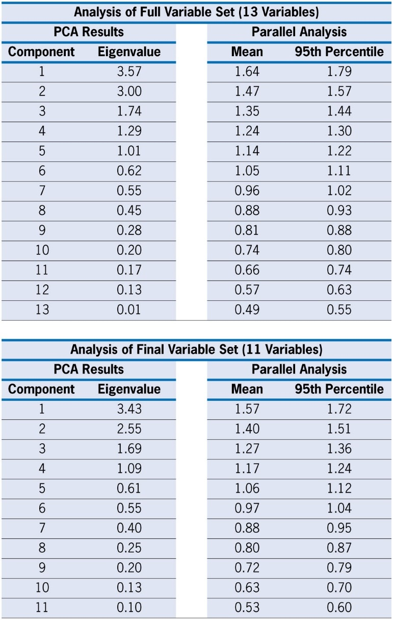
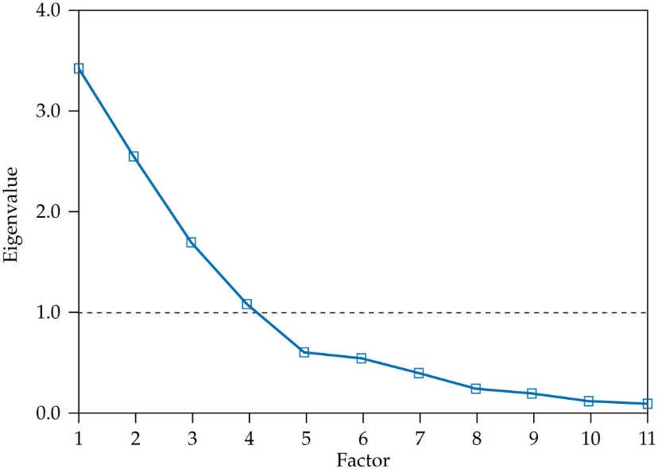
Scree Test and Parallel Analysis for Component Analysis
For use with Hair, Black, Babin and Anderson, Multivariate Data Analysis 8e © 2018 Cengage Learning EMEA

Slide 58
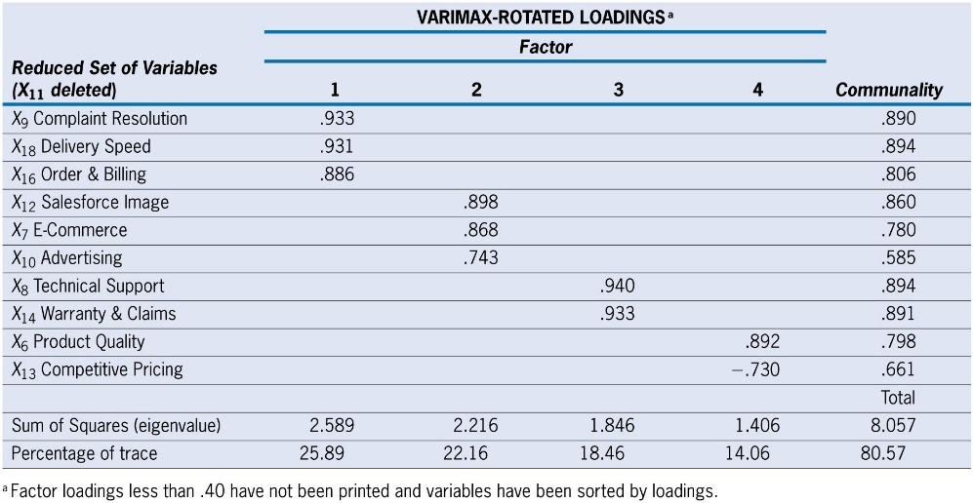
Final Results: Rotated Component Matrix of “Reduced Set” of HBAT Perceptions Variables
For use with Hair, Black, Babin and Anderson, Multivariate Data Analysis 8e © 2018 Cengage Learning EMEA

Slide 59
Factor Analysis Learning Checkpoint
What are the major uses of exploratory factor analysis?
What is the difference between component analysis and common factor analysis?
Is rotation of factors necessary?
How do you decide how many factors to extract?
What is a significant factor loading?
How and why do you name a factor?
Should you use factor scores or average summated ratings in follow-up analyses?
For use with Hair, Black, Babin and Anderson, Multivariate Data Analysis 8e © 2018 Cengage Learning EMEA

